Slide 1
The F-35 Cockpit: Enabling the Pilot as a Tactical Decision Maker
Michael L. Skaff
F-35 Pilot Vehicle Interface

Slide 2
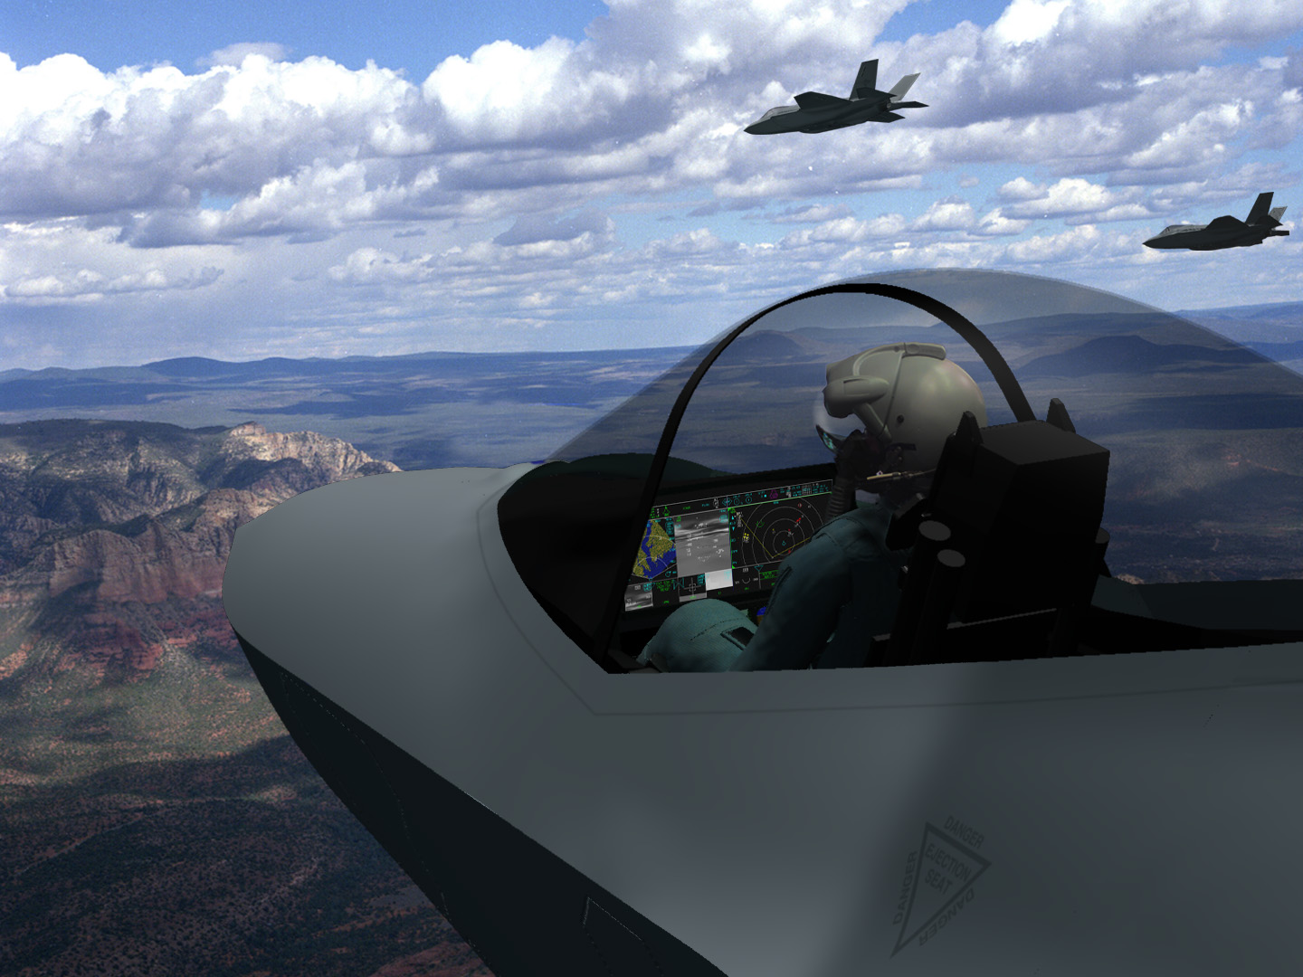
F-35 Cockpit
8- by 20-inch Contiguous Display with Portal Formatting Concept to Improve Information Cognition, System Control, and Flexibility
Wide FOV HMD w/ Virtual HUD Spherical IR & low light Imagery to Improve SA in All Weather and Night Operations
Stereo Audio & Voice Control Increase Information Quantity and Quality While Decreasing Pilot Workload
Novel STOVL Controls Reduce Training Requirements Provides Controllability with Fewer Inceptors
Maximized Accommodation
For Higher Utility & Safety
Active Inceptors
Compound Rudder Adjustment
Data Bus Communication for Ejection Seat
Tilting Seat (adjustment Limited for ejection safety)
Integrated Life Support System
Next-Generation Escape System
Auto-ejection
New Technologies and an Innovative Approach to Pilot Vehicle Interface Produce a Capable and Flexible Cockpit
Notes:
The highlights of the F-35 cockpit are:
PCD - a large Panoramic Cockpit Display (PCD) which is a 20 x 8 inch contiguous piece of glass. The pilot interacts with this display through touch, cursor hooking, and voice recognition.
HMD - the pilot wears a Helmet Mounted Display (HMD) in lieu of a physical Head-up Display (HUD). A virtual HUD (vHUD) is projected onto the visor. The vHUD is presented to each eye and is 40 deg wide by 30 degrees tall.
Audio & Voice - stereo wiring is used in the headset in order to facilitate full 3-D audio as a software upgrade. A Voice Recognition System (VRS) is used for “housekeeping” chores.
STOVL - the Short Takeoff and Vertical (STOVL) mode has been designed for safety and simplicity. The STOVL mode is extremely safe and easily trained to. In actual flight test non-STOVL pilots have been able to master it in solo on their first flight.
JPATS - the F-35 cockpit is designed to accommodate the full JPATS flying population from a 245lb man to a 104lb woman.
Escape - a Martin-Baker Mk-16 ejection seat provides for safe ejection. In the B-model, when in STOVL mode, the seat is automatically triggered to improve safety beyond the human’s ability to react.

Slide 3
Cockpit Philosophy
Let the Pilot be the Tactician By
Managing Workload
Automation Of Tasks
Let Computers Do What Computers Do Best
Let the Pilot Do What Pilots Do Best
Providing Tools That Build And Maintain Situation Awareness (SA) pursuant to Information Dominance
Concise Information
Timely Information
Quickly Interpreted Information
Realize That All Design Efforts Are Based On Combat Value Added:
The Requirement is to Increase
Lethality and Survivability Beyond that of Current Aircraft
Notes:
The Pilot Vehicle Interface (PVI) design philosophy is “return the pilot to the role of tactician.” This is accomplished by managing workload and providing the tools which will build and maintain situation awareness. But more than that, information dominance is the design result. The F-35 is a complete weapon system and multiple F-35s are more than the sum of the air vehicles. When a flight or division of F-35s enter battlespace they become the dominant factor.

Slide 4
Controls & Displays
Internal Environment
External Environment
Controls
A/C System Manager
Tactical Sensor Manager
PILOT
Sensor Suite
A/C Systems
Prognostic Health Manager
Combat Flight Manager
Displays
Pilot Centered Design Approach
Notes:
The PVI was designed by pilot for pilots. This design approach views the pilot at the center of the of the air vehicle. From this point of view two control and feedback loops exist: 1) the internal loop and 2) the external loop. The external loop is the one featured in “Top Gun.” This the fly and fight loop, but the internal loop is equally important. The internal loop is all about getting the air vehicle safely into and out of battlespace. This is required in order to fly and fight.

Slide 5
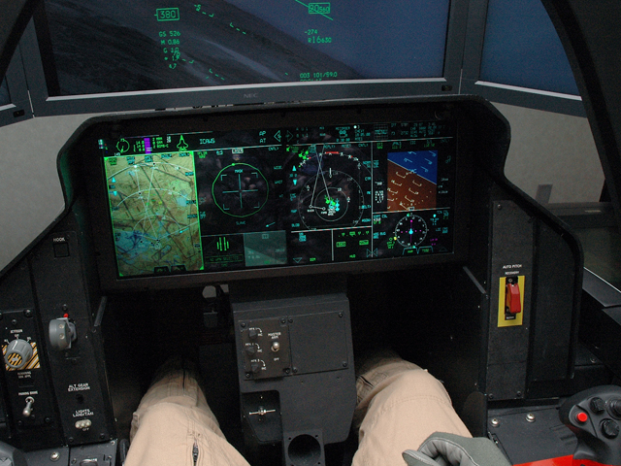
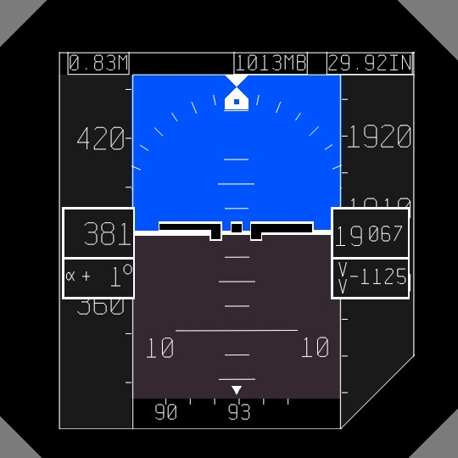
F-35 Cockpit Display
Notes:
The PCD is the first thing which the casual observer notices about the F-35 cockpit. The PCD is a contiguous 20 x 8 inch surface which is composed of two physical 10 x 8 inch displays for redundancy. This display space may be configured based on pilot needs into 12 windows of various and content, location, and size. The larger windows are referred to as portals. There are four portals. The small windows at along the bottom are secondary windows and there are 8 of them. The entire surface may be controlled through touch, cursor hooking, or voice control.
Upon closer inspection of the cockpit most recognize the paucity of switches and instruments. In fact, many pilots say this is the most naked cockpit in history (this is not true, the Wright flyer had fewer switches). During the initial design everything was removed from the cockpit volume and had to earn its way back into the cockpit based on “combat value added.” Combat value means it must contribute directly to lethality, survivability, and be cost effective. Cost effective is “bang for the buck.”

Slide 6
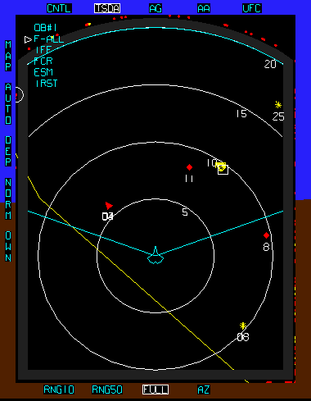
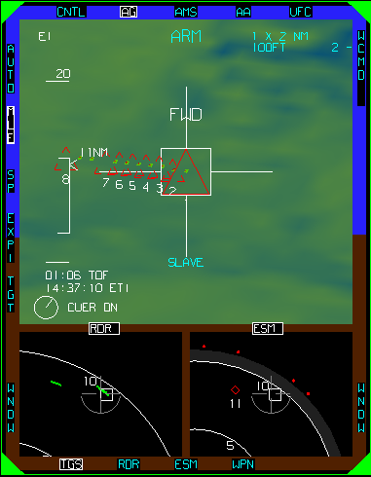
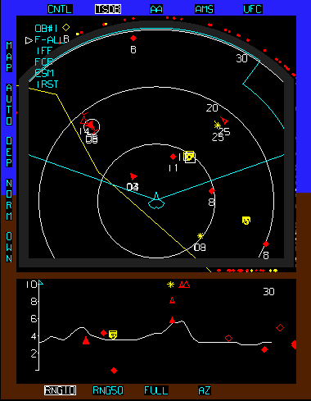
JSF Conceptual Displays
Air to Ground TSD
Mission Tailorable
Air to Air TSD
Information Dominance -vs- Information Overload
Notes:
The initial implementation of the PCD was one physical display of 16 x 9 inches. This design had three portals and 6 secondary windows. The design worked, but pilots asked for another portal.

Slide 7
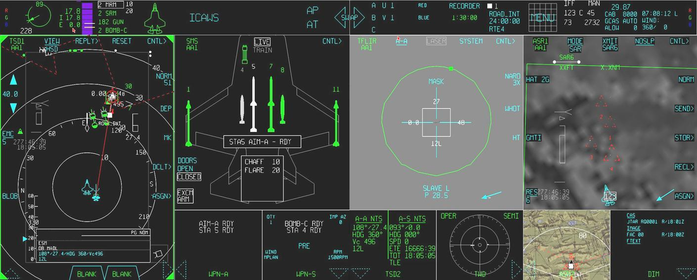
F-35 Panoramic Cockpit Display
Tactical Situation Display
Targeting FLIR
Stores Management Display
Synthetic Aperture Radar
Notes:
The current F-35 looks like this. In this example the pilot has configured the PCD into 4 portals with 6 secondary windows. There are 5 portal configurations which the pilot can program prior during mission planning. Once airborne, it is extremely easy to use the touchscreen to re-configure PCD.

Slide 8
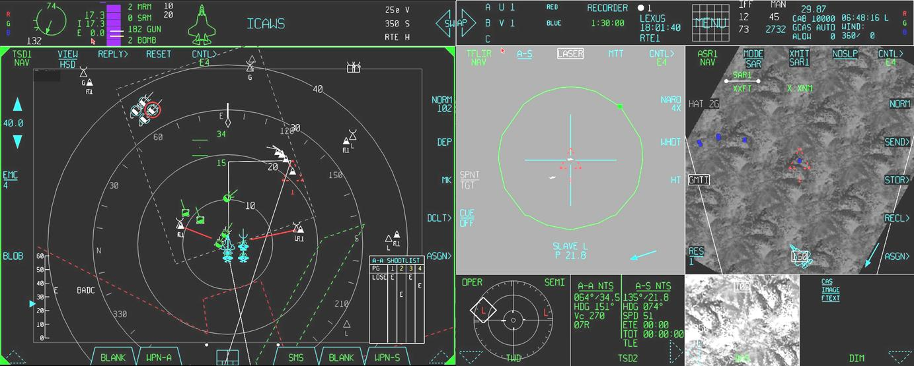
F-35 Panoramic Cockpit Display
Tactical Situation Display (double wide)
Targeting FLIR
Synthetic Aperture Radar (ground movers)
Notes:
In this example we see three portals and 4 secondary windows. Portal one, on the left, is a large Tactical Situation Display (TSD). It is onto the format that fusion presents its view of battlespace. All F-35s share this view and contribute to its content. This is also the primary location that the pilot interacts with the air vehicle to sort and target. The two portals on the right are showing sensor data. In this case the Electro-optical Targeting System (EOTS) and the Synthetic Aperture Radar (SAR).

Slide 9
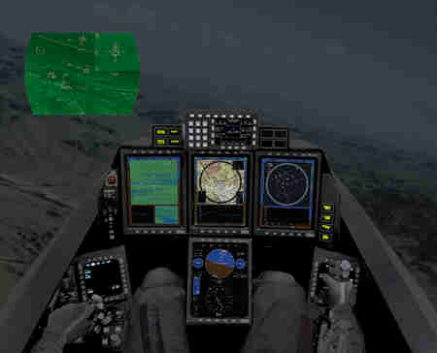
Mission Reconfigurable Cockpit
Notes:
The Mission Reconfigurable Cockpit (MRC) was a Contract Research and Development (CRaD) program which we had back in the early 90’s. During this program we explored advanced fighter cockpit concepts. Among these were vHUD, touch, voice recognition, and accommodation. The results of this research became the foundation of the F-35 cockpit 10 years later.

Slide 10
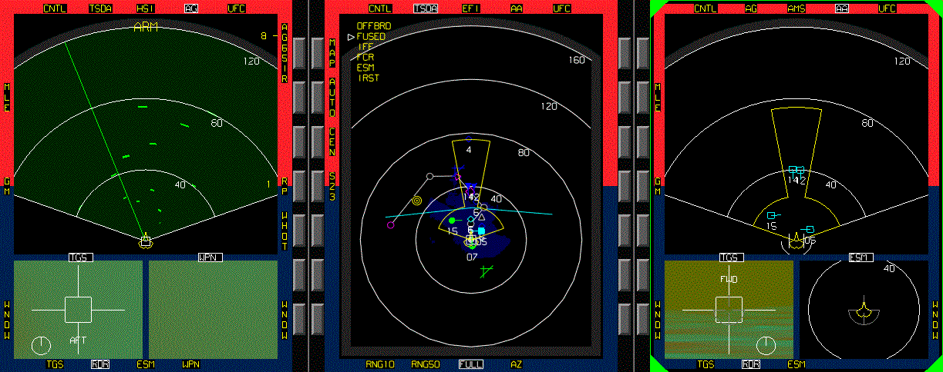
Mission Reconfigurable Cockpit
Primary concepts:
- Master-Modeless
- Rule based Tactical Sensor Manager
- Mission Integrated Flight Controls
- Auto Target Cueing
Air to Ground Format
Tactical Situation Display
Air to Air Format
Notes:
The MRC contract allowed us to explore the under pinnings of information dominance. The greatest challenge is how to bridge the gulf between information overload and information dominance.
Think of it this way: when you look at a populated spreadsheet you see data. Data is important, but it is extremely difficult to understand by just looking at it.
If you graph the data the meaning and importance becomes obvious. We’ll call this information. We can act on information unless there is too much of it.
We need to cull out which information is of most importance for the immediate task at hand. We call this INFORMATION DOMINANCE. Information dominance is what makes the F-35 unlike any other weapon system.

Slide 11
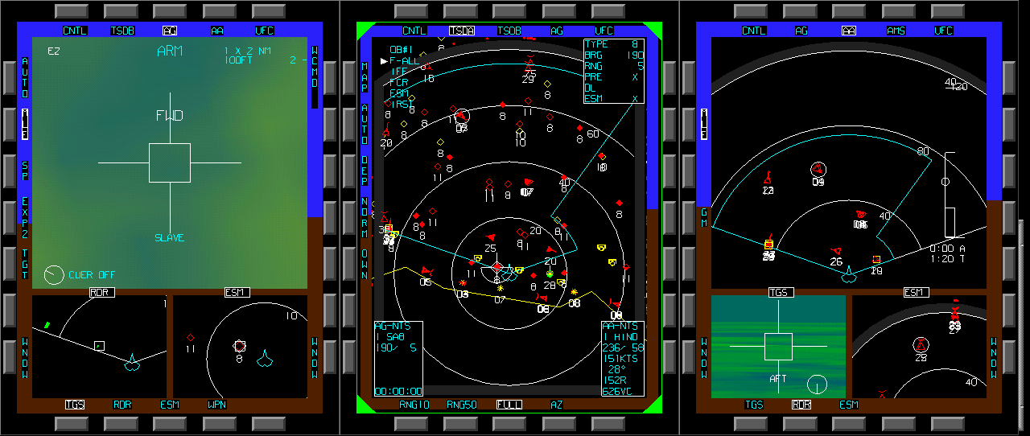
Joint Attack Strike Technology
Primary concepts:
- System of Systems
- Advanced Information Management System
- Sensor measurement errors “not a perfect world”
Air to Ground Format
Tactical Situation Display
Air to Air Format
Notes:
The follow on contract to the MRC CRaD was called Joint Attack Strike Technology Onboard/offboard (J/OBOB). This research assumed that the 5th generation tactical fighters would be connected. They could literally have an IP address and receive intelligence feeds while airborne.
This really complicated the issue of information dominance. It’s like a Google search which returns ten thousand results. You suspect the desired result is out there, but how do you get to it.

Slide 12
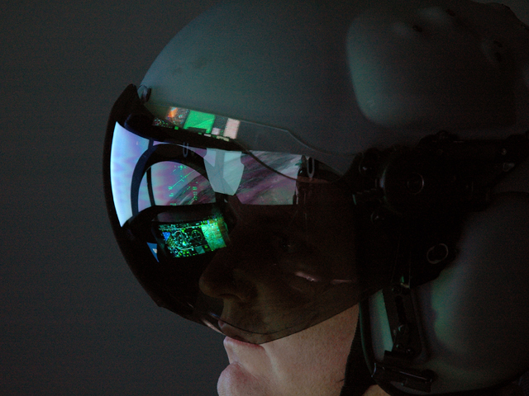
F-35 Helmet Mounted Display
Virtual Head-up Display, no Physical HUD in Jet
Notes:
The vHUD being projected onto the visor is new technology and will change tactical employment. The jump from 3rd gen fighters to 4th gen brought a full head-up display. The HUD was a paradigm shift which dramatically improved lethality and survivability. In similar fashion the jump to 5th gen with a vHUD is a paradigm shift and has the potential to revolutionize employment.
A physical HUD projects into about 1200 square degrees of battlespace directly in front of the aircraft. The HMD with vHUD opens the view into over 41000 square degrees. This is the full sphere surrounding the aircraft.

Slide 13
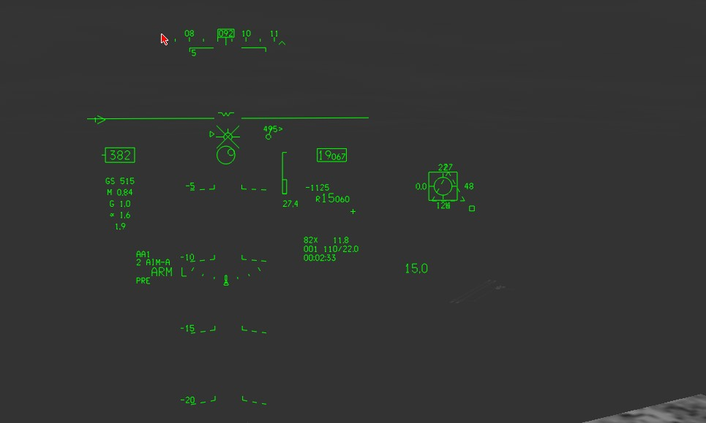
F-35 Helmet Mounted Display
Virtual HUD Looking Forward
Target Designation Symbology at Edge of Field of View
Notes:
This is an example of the vHUD when the pilot looks directly forward where a physical HUD would be. F-35 pilots report that in about 10 minutes they become accustomed to the vHUD. The pilots recognize the potential improvements in lethality and survivability of the HMD.
.

Slide 14
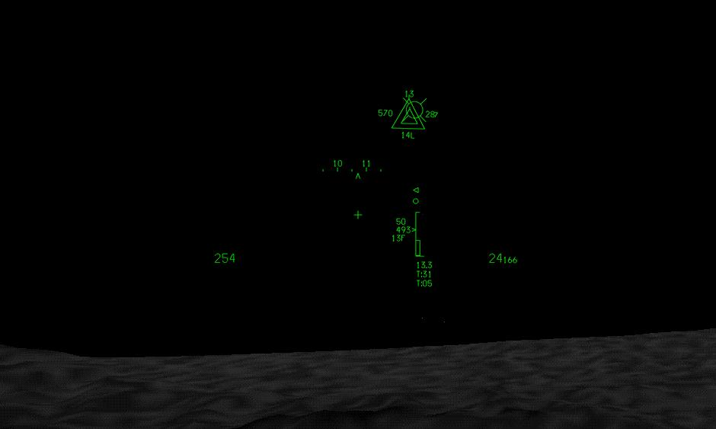
F-35 Helmet Mounted Display
Helmet Mounted Display Looking Behind the Aircraft
Enemy Air Target Designator Symbols
Ownship Missile In-flight
Notes:
This is an example of off axis symbology. In general, we only take key flight parameters and tactical symbology off axis. In the future we will investigate off axis attitude awareness symbology. The mil standards don’t yet address HMDs and off axis symbolgy. We will work with the Services to improve and update The standard as well as the HMD symbology.

